Slide 1
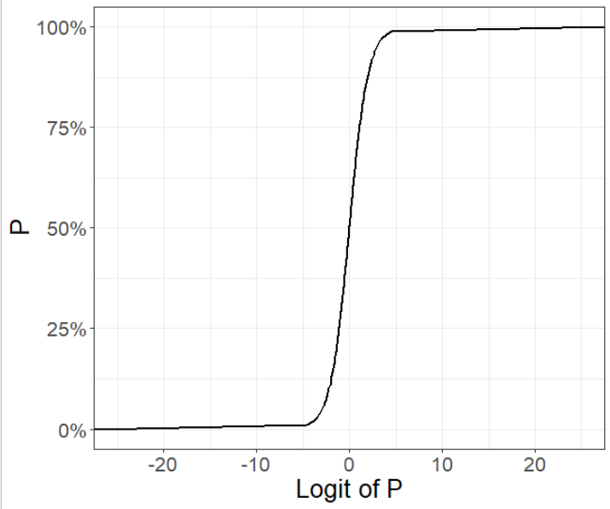
The logit link function

Slide 2
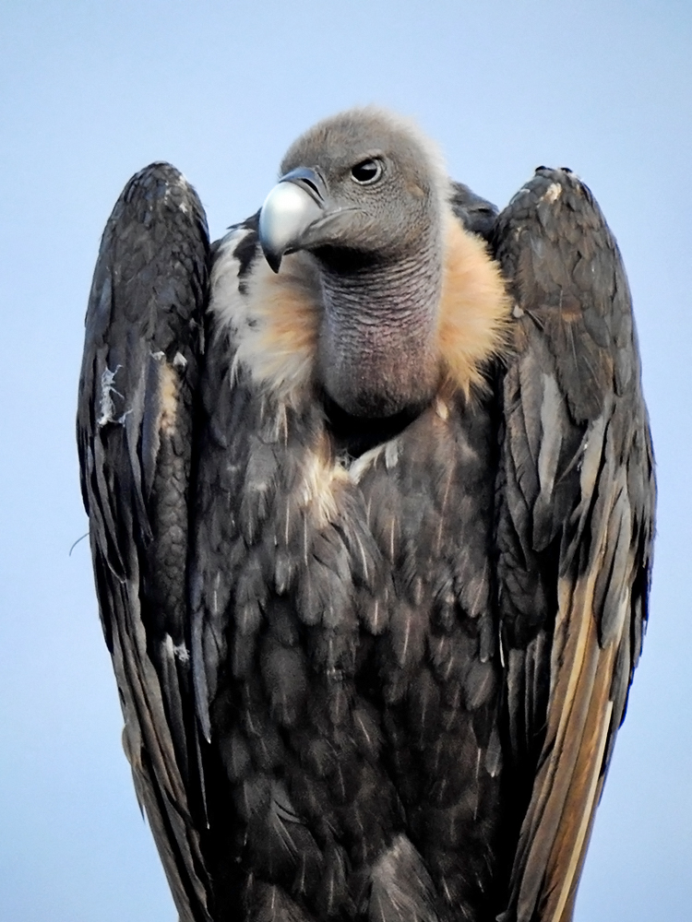

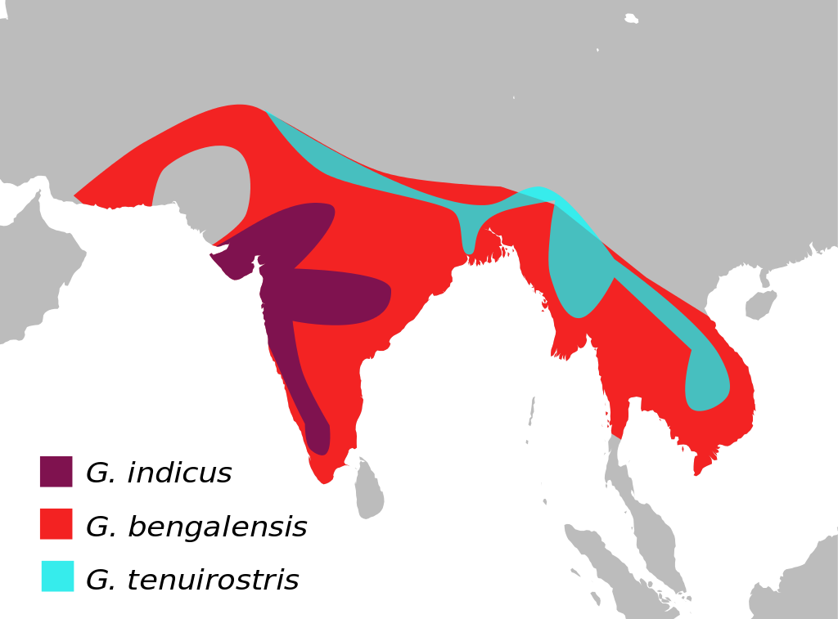
Capturing white-rumped vultures at feeding stations
Each feeding station supplies a different amount of food (10 stations)
We have an a priori hypothesis that the more food at a feeding station, the higher the chance is that we will capture an eagle
We are not doing any fancy CMR trapping
Just throwing students at vultures
So we just want to know how good you are at jumping on vultures

Slide 3

Feeding station

Slide 4
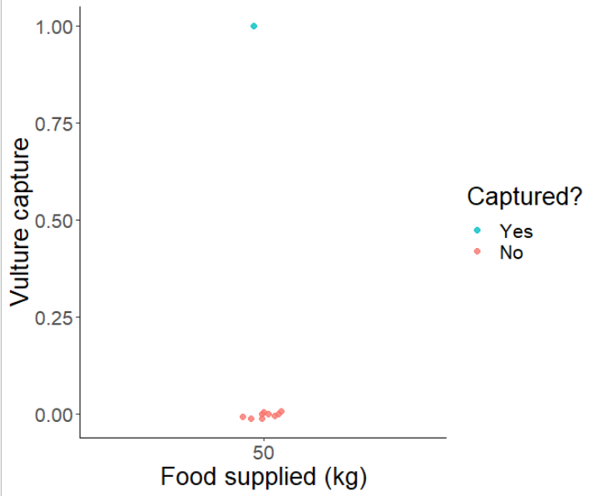
After one bout of trapping

Slide 5
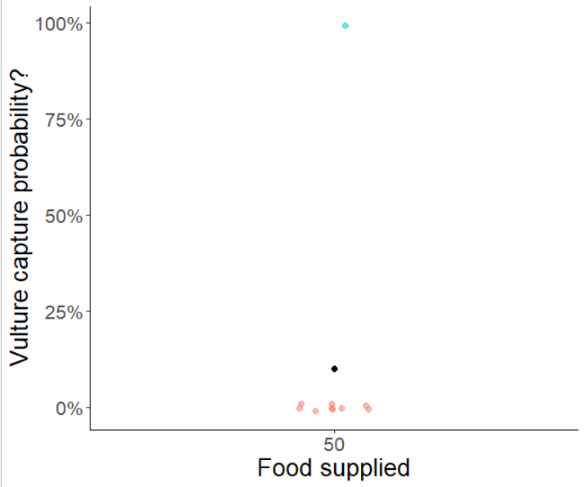
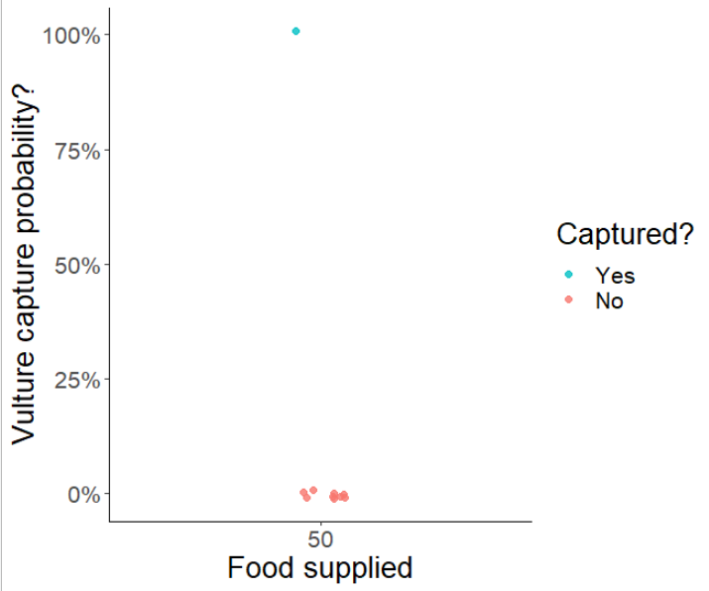
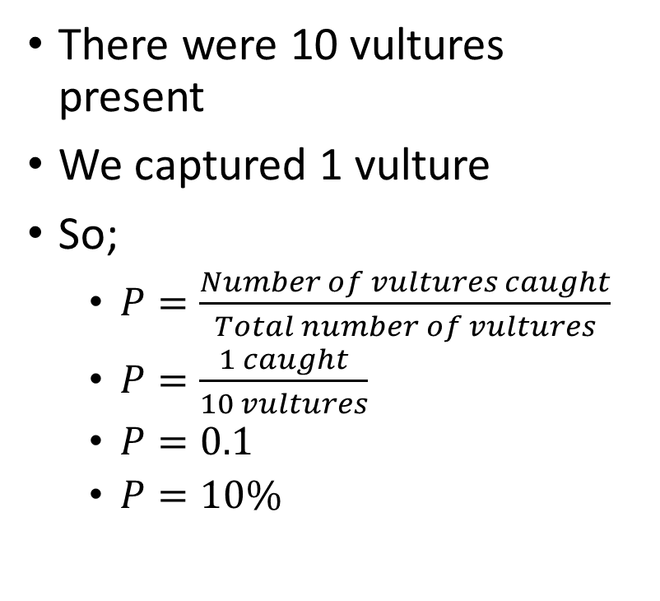
What is our capture probability?
There were 10 vultures present
We captured 1 vulture
So;
$P=\frac{Number of vultures caught}{Total number of vultures}$
$P=\frac{1 caught}{10 vultures}$
$P=0.1$
$P=10\%$
P = 10% for this station

Slide 6
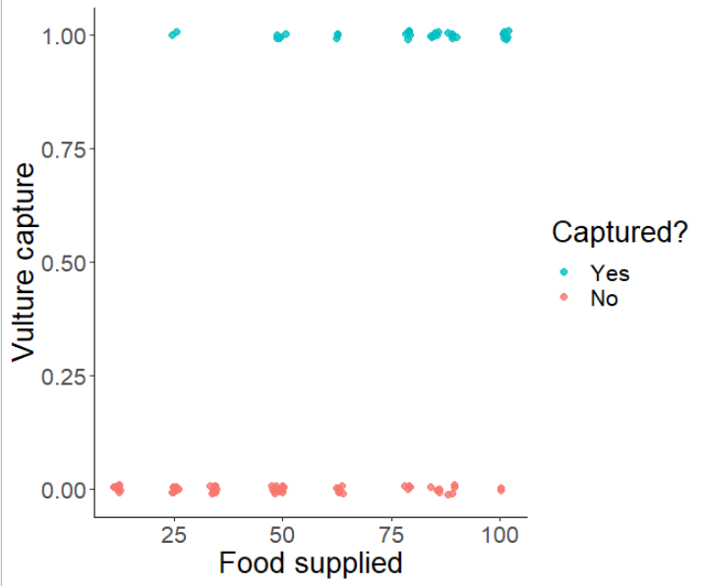
But what about with 10 stations?

Slide 7
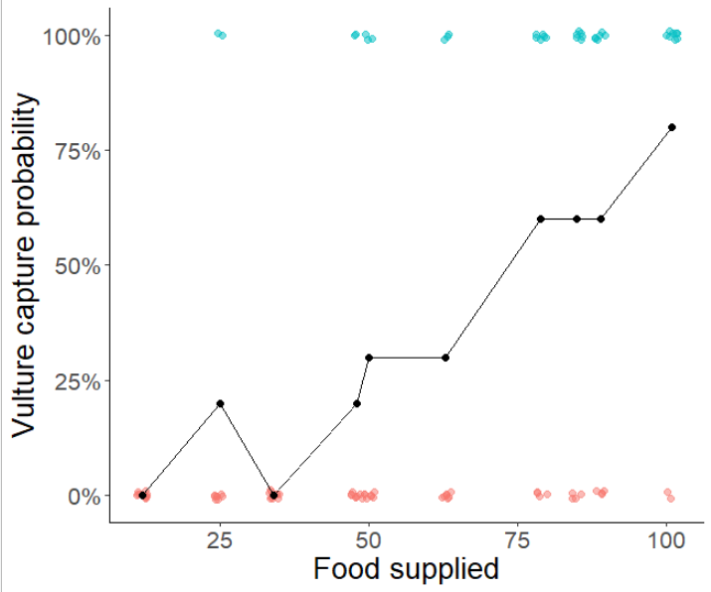
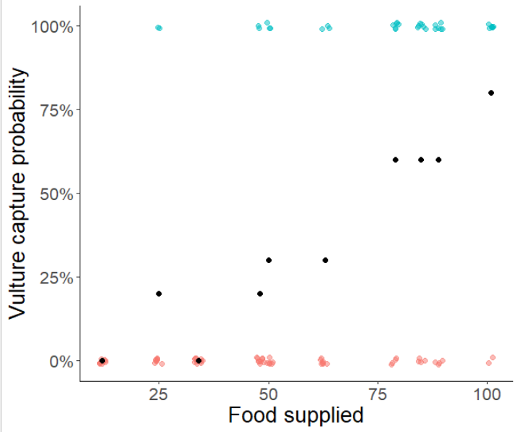
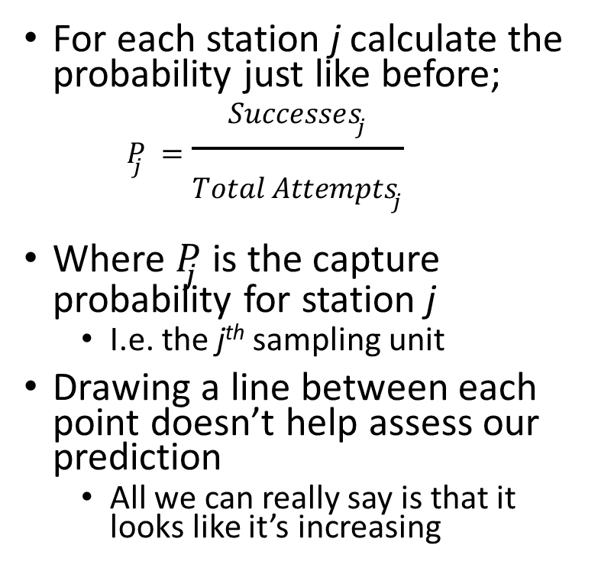
Calculate P for each station
For each station j calculate the probability just like before;
$$P_{j}=\frac{Successes_{j}}{Total Attempts_{j}}$$
Where $P_{j}$ is the capture probability for station j
I.e. the j^{th} sampling unit
Drawing a line between each point doesn’t help assess our prediction
All we can really say is that it looks like it’s increasing

Slide 8
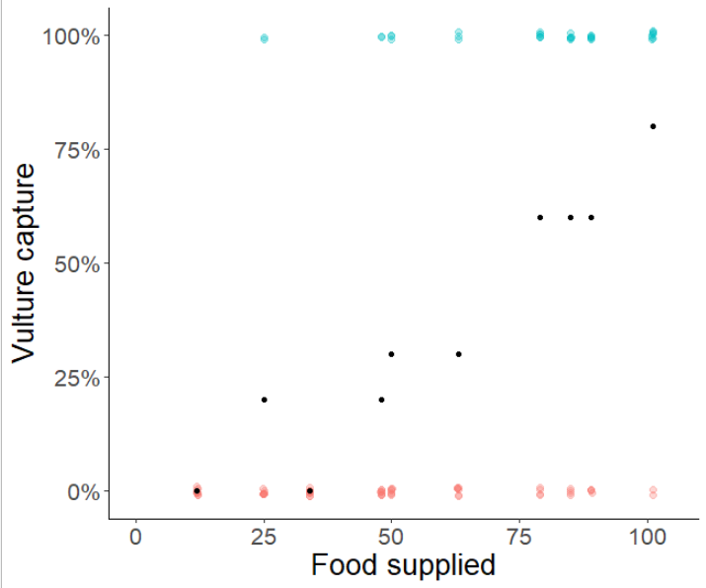

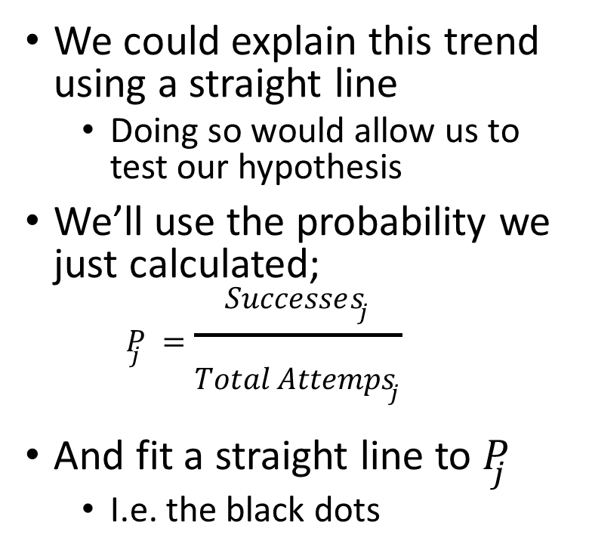
What about using $y = mx + c$?
We could explain this trend using a straight line
Doing so would allow us to test our hypothesis
We’ll use the probability we just calculated;
$$P_{j}=\frac{Successes_{j}}{Total Attemps_{j}}$$
And fit a straight line to $P_{j}$
I.e. the black dots

Slide 9
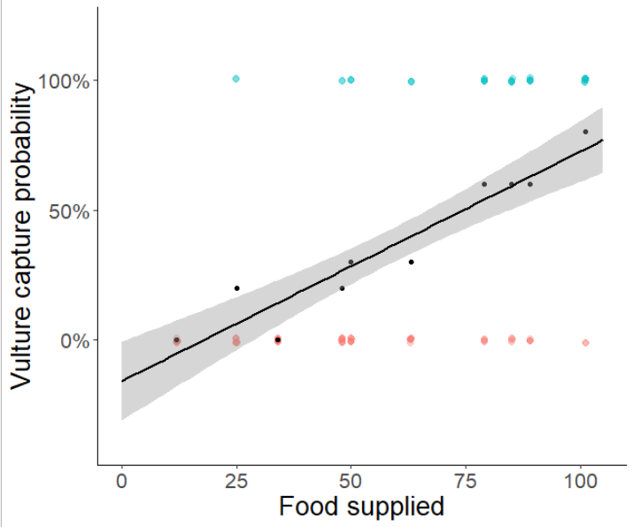
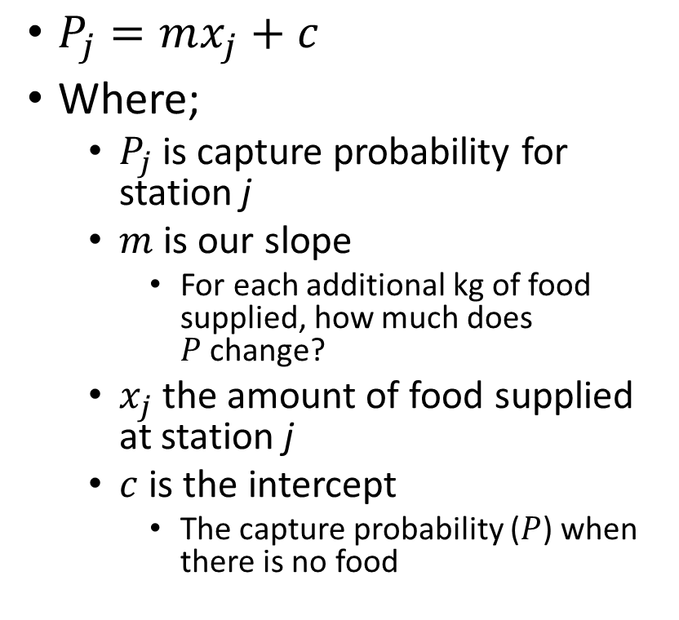
Fitting a straight line
$P_{j}=mx_{j}+c$
Where;
$P_{j}$is capture probability for station j
$m$ is our slope
For each additional kg of food supplied, how much does $P$change?
$x_{j}$ the amount of food supplied at station j
$c$ is the intercept
The capture probability ($P$) when there is no food

Slide 10
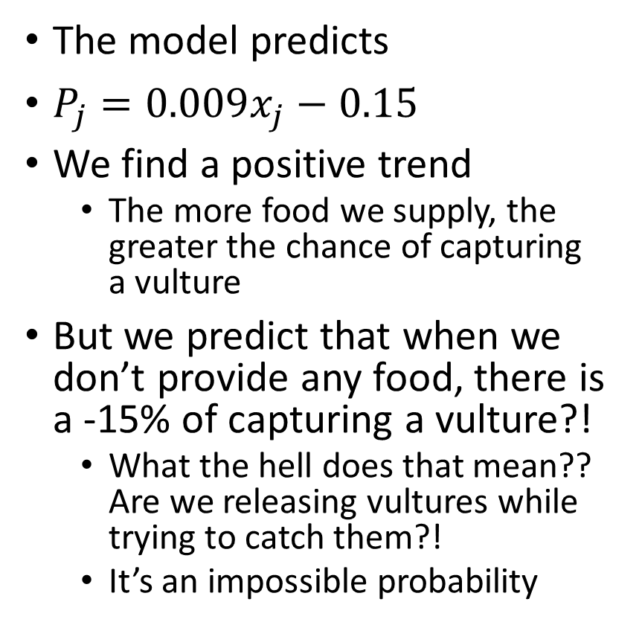
What does the model predict?
The model predicts
$P_{j}=0.009x_{j}−0.15$
We find a positive trend
The more food we supply, the greater the chance of capturing a vulture
But we predict that when we don’t provide any food, there is a -15% of capturing a vulture?!
What the hell does that mean?? Are we releasing vultures while trying to catch them?!
It’s an impossible probability

Slide 11
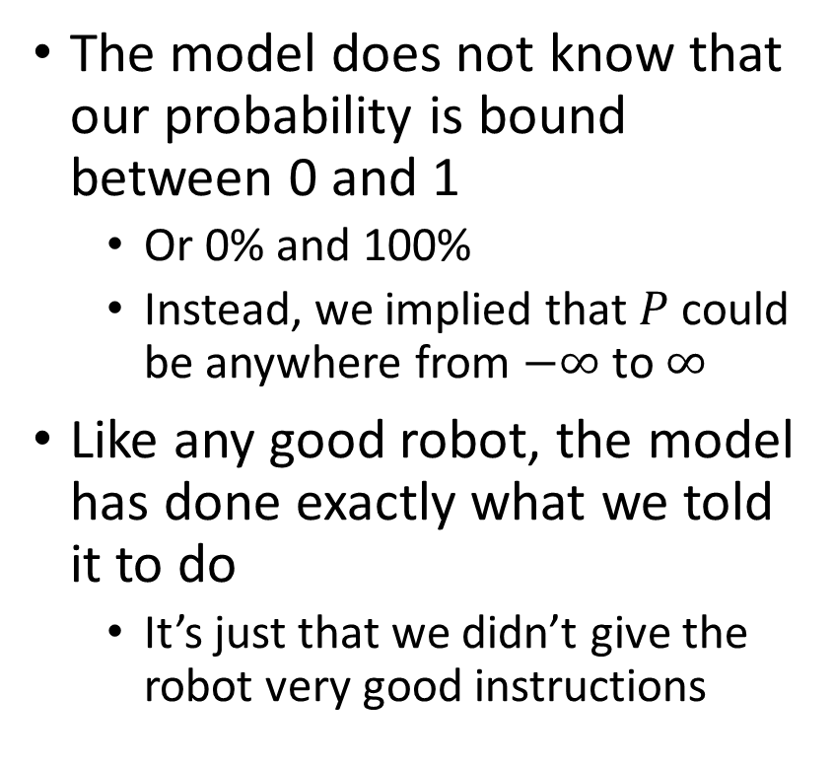
What went wrong?
The model does not know that our probability is bound between 0 and 1
Or 0% and 100%
Instead, we implied that $P$ could be anywhere from $−∞$ to $∞$
Like any good robot, the model has done exactly what we told it to do
It’s just that we didn’t give the robot very good instructions

Slide 12
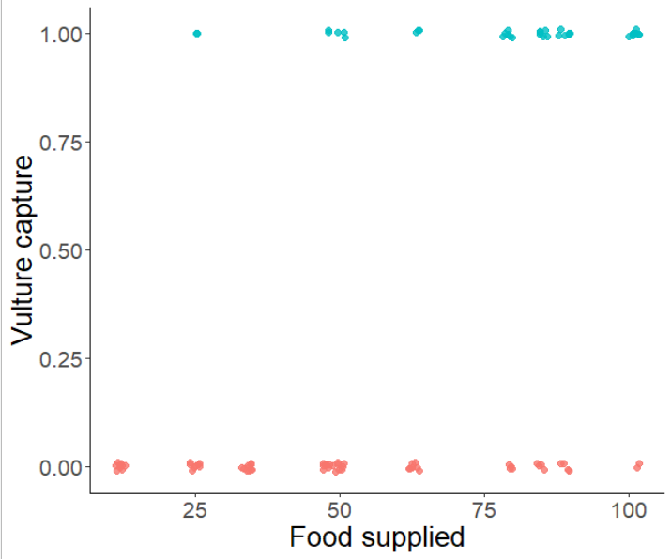
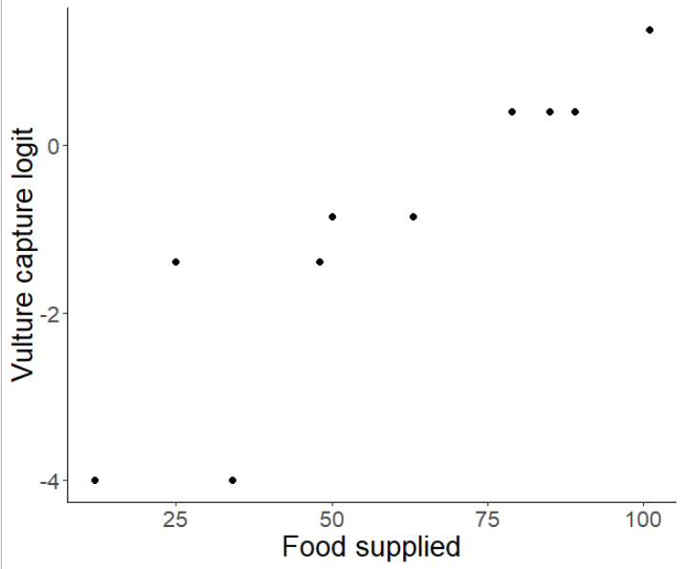
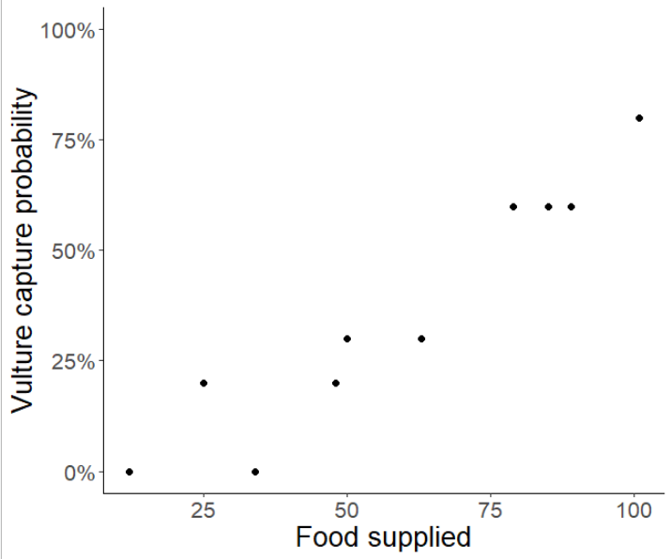
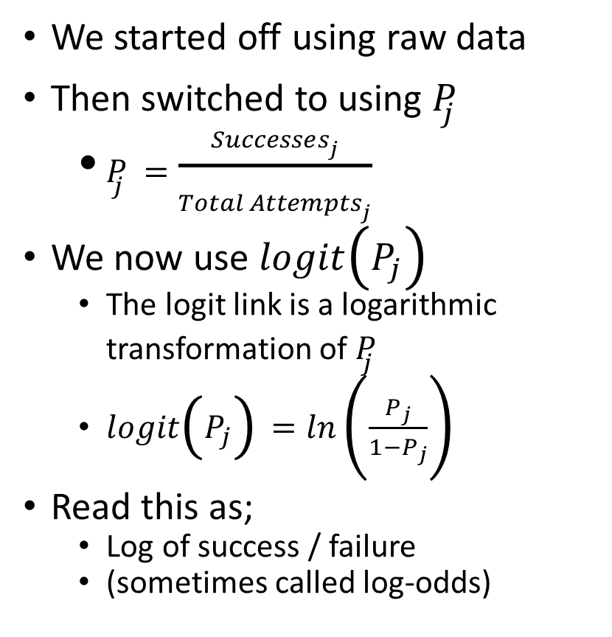
Introducing, the logit link function
We started off using raw data
Then switched to using $P_{j}$
$P_{j}=\frac{Successes_{j}}{Total Attempts_{j}}$
We now use $logit\left(P_{j}\right)$
The logit link is a logarithmic transformation of $P_{j}$
$logit\left(P_{j}\right)=ln\left(\frac{P_{j}}{1−P_{j}}\right)$
Read this as;
Log of success / failure
(sometimes called log-odds)

Slide 13
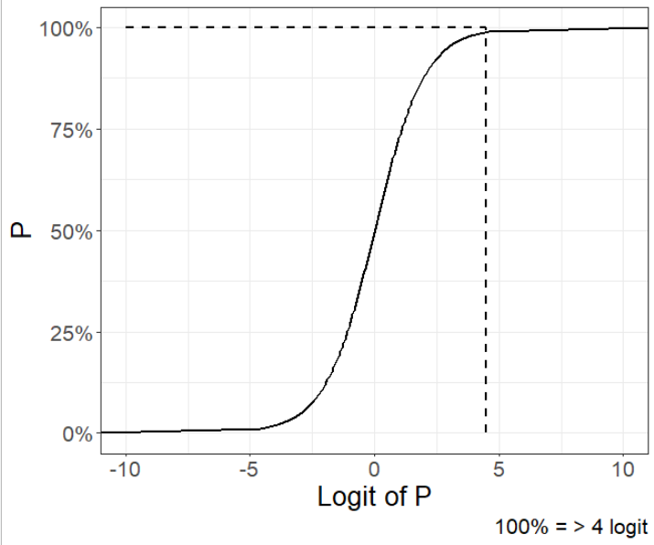
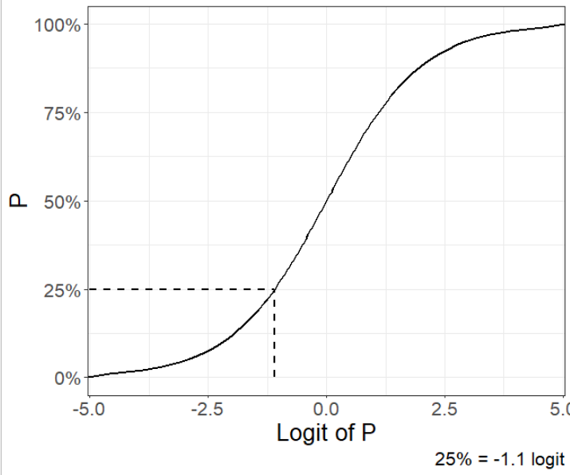
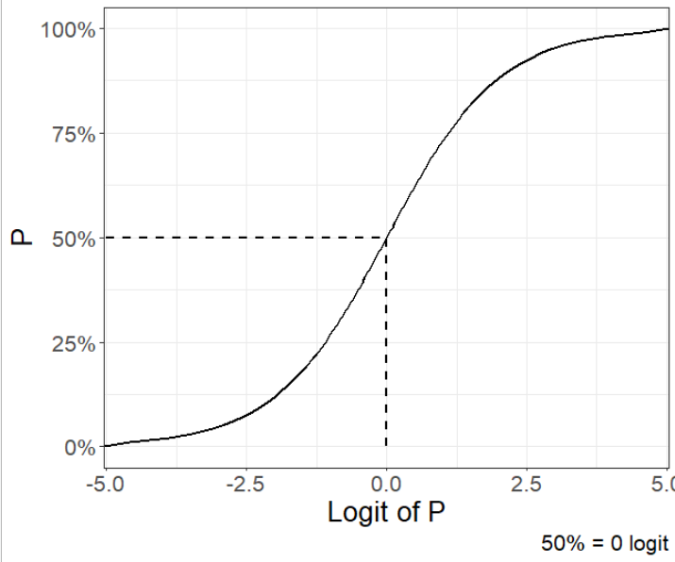
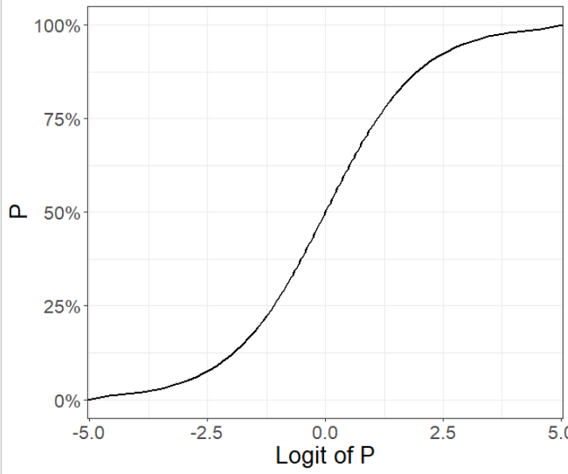
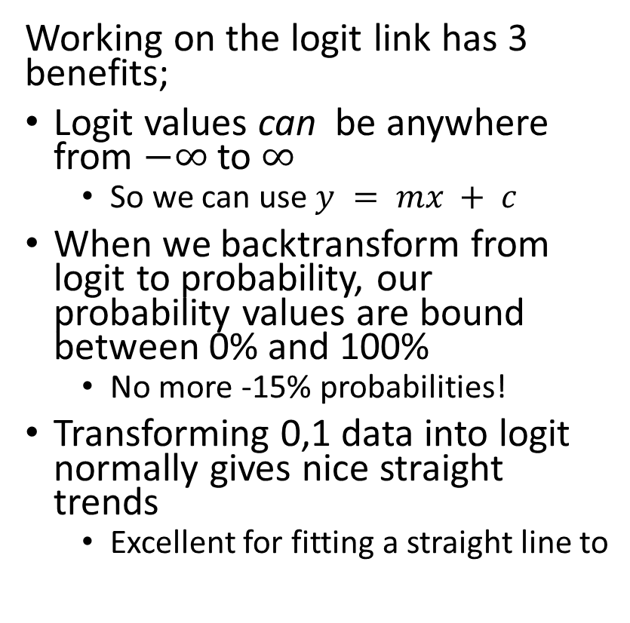
How P and logit(P) relate with each other
Working on the logit link has 3 benefits;
Logit values can be anywhere from $−∞$ to $∞$
So we can use $y = mx + c$
When we backtransform from logit to probability, our probability values are bound between 0% and 100%
No more -15% probabilities!
Transforming 0,1 data into logit normally gives nice straight trends
Excellent for fitting a straight line to

Slide 14
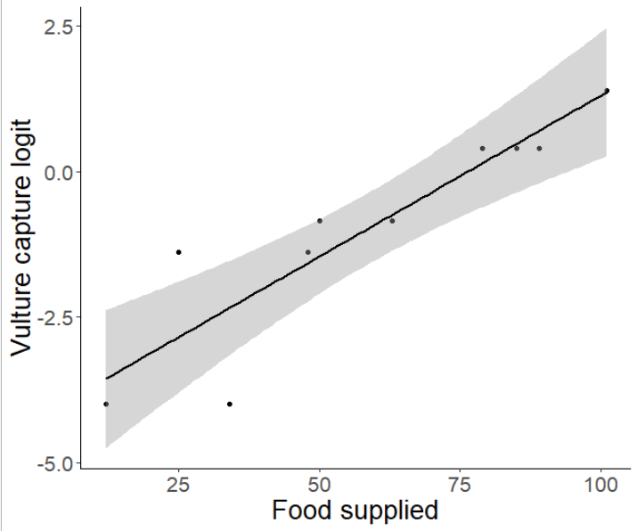
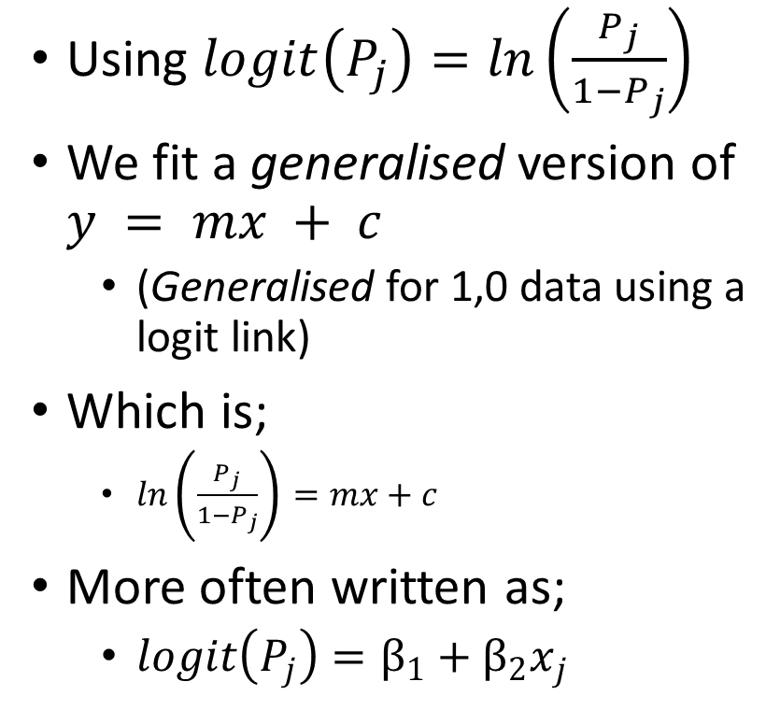
Fitting a straight line to 1,0 data using logit
$$logit\left(P_{j}\right)=−3.7+0.05x_{j}$$
Using $logit\left(P_{j}\right)=ln\left(\frac{P_{j}}{1−P_{j}}\right)$
We fit a generalised version of $y = mx + c$
(Generalised for 1,0 data using a logit link)
Which is;
$ln\left(\frac{P_{j}}{1−P_{j}}\right)=mx+c$
More often written as;
$logit\left(P_{j}\right)=β_{1}+β_{2}x_{j}$

Slide 15
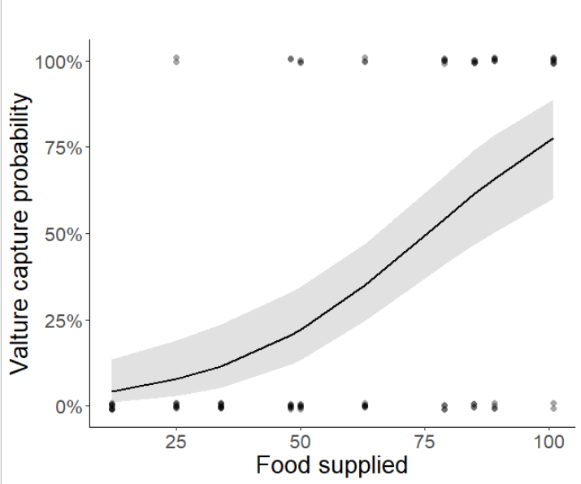
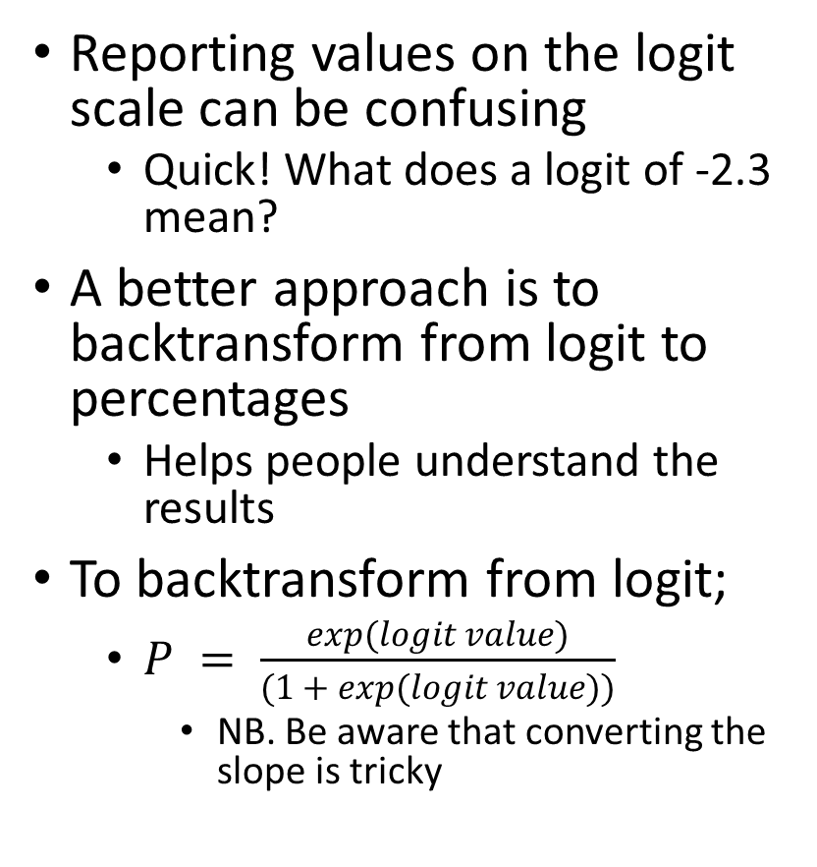
Backtransform to the real scale
Reporting values on the logit scale can be confusing
Quick! What does a logit of -2.3 mean?
A better approach is to backtransform from logit to percentages
Helps people understand the results
To backtransform from logit;
$P = \frac{exp(logit value)}{(1 + exp(logit value))}$
NB. Be aware that converting the slope is tricky

Slide 16




tl;dr
$$P_{j}=\frac{Successes_{j}}{Total Attempts_{j}}$$
$$logit\left(P_{j}\right)=ln\left(\frac{P_{j}}{1−P_{j}}\right)$$
$$logit\left(P_{j}\right)=β_{1}+β_{2}x_{j}$$
$$P = \frac{exp(logit value)}{(1 + exp(logit value))}$$

